Slide 1
Project Group 18 UST Freshmen Chatbot
Chan Yee San Samuel
Leung Cheuk Nam
Liu Yan Ho
Fung Yuk Cheung
Lai Yui Fung

Slide 2
Basic Hierarchy of our chatbot
Category
<- Academic
<- Course
<- CourseWebsiteSearch
<- CreditTransfer
<- Staff
<- Campus
<- CampusETA
<- Function
<- TimeTable
<- Social
<- Recreation
<- Societies
<- Transport
<- Bus
<- Minibus
<- Instruction

Slide 3
Academic <- Course
-

Slide 4
Academic <- CourseWebsiteSearch
-

Slide 5
Academic <- CreditTransfer
Provide credit transfer information for students
taken local / non-local examinations, e.g. HKALE, GCEAL
promoted from local institution
in exchange

Slide 6
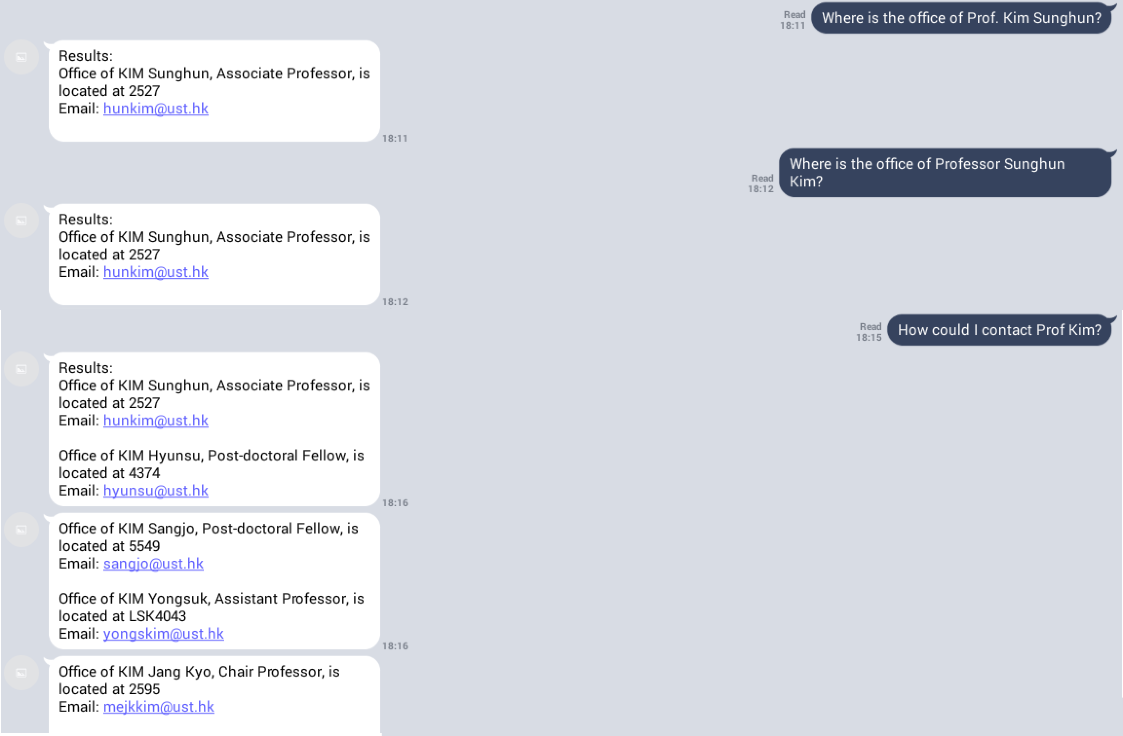
Academic <- Staff
- Help users find the office location, contact info of professor / TA

Slide 7
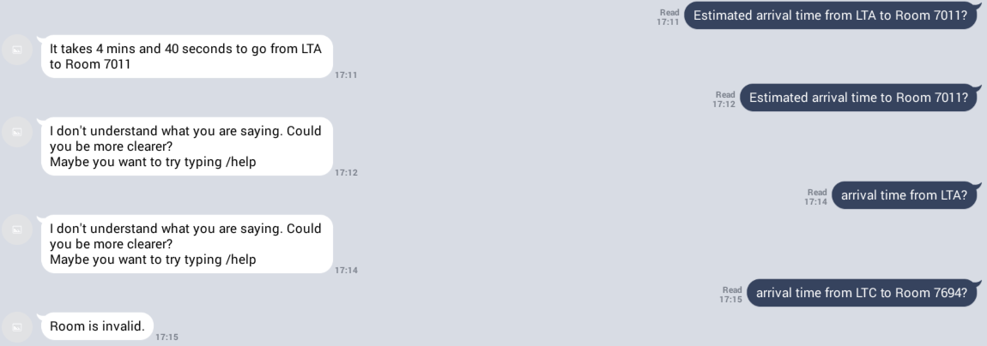
Campus <- CampusETA
Help users estimate the arrival time from one location to another throughout the UST campus
Data crawled from pathadvisor.ust.hk

Slide 8
Function <- TimeTable
- Assist users to manage their time effectively

Slide 9
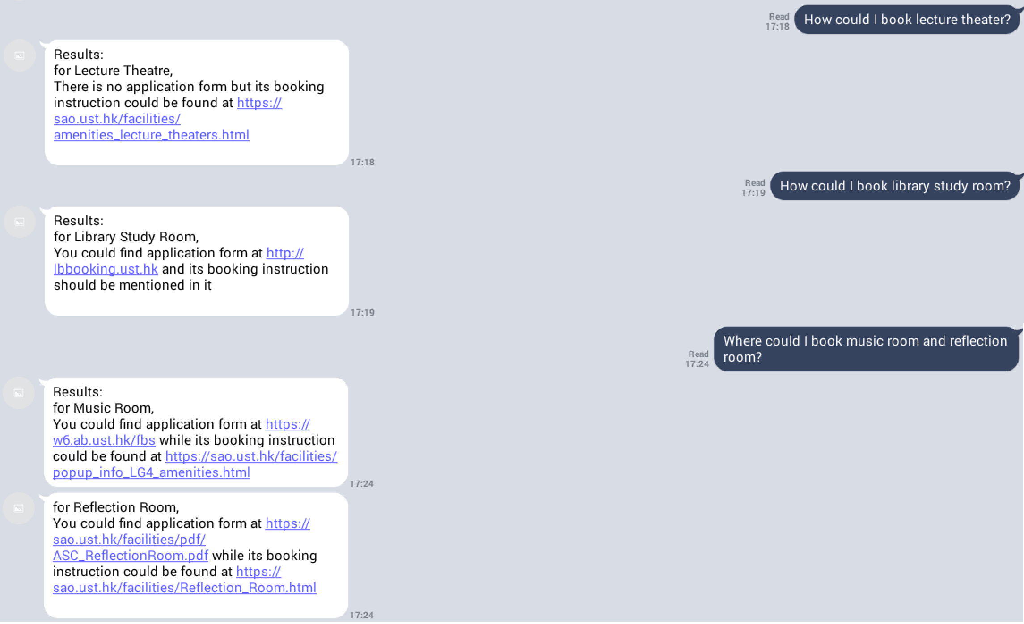
Social <- Recreation
Help users search websites for booking UST amenities, e.g. library study room, music room

Slide 10
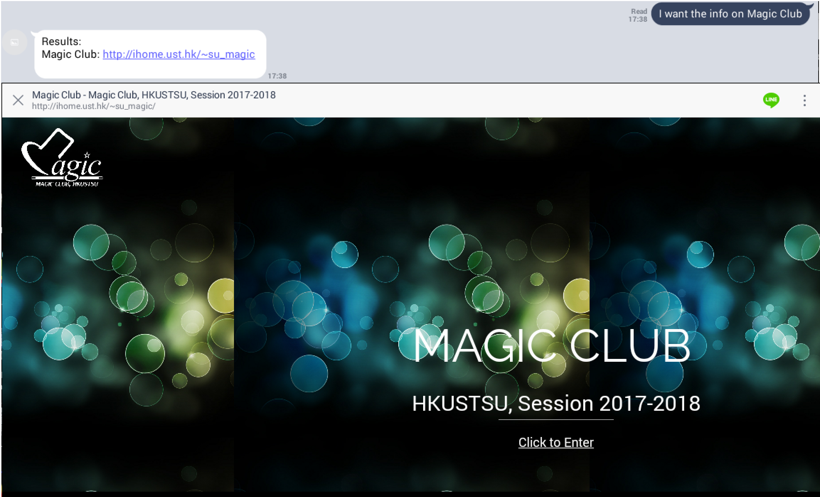
Social <- Societies
- Help users find webpages of UST societies, e.g. Debating Society, Drama Society

Slide 11
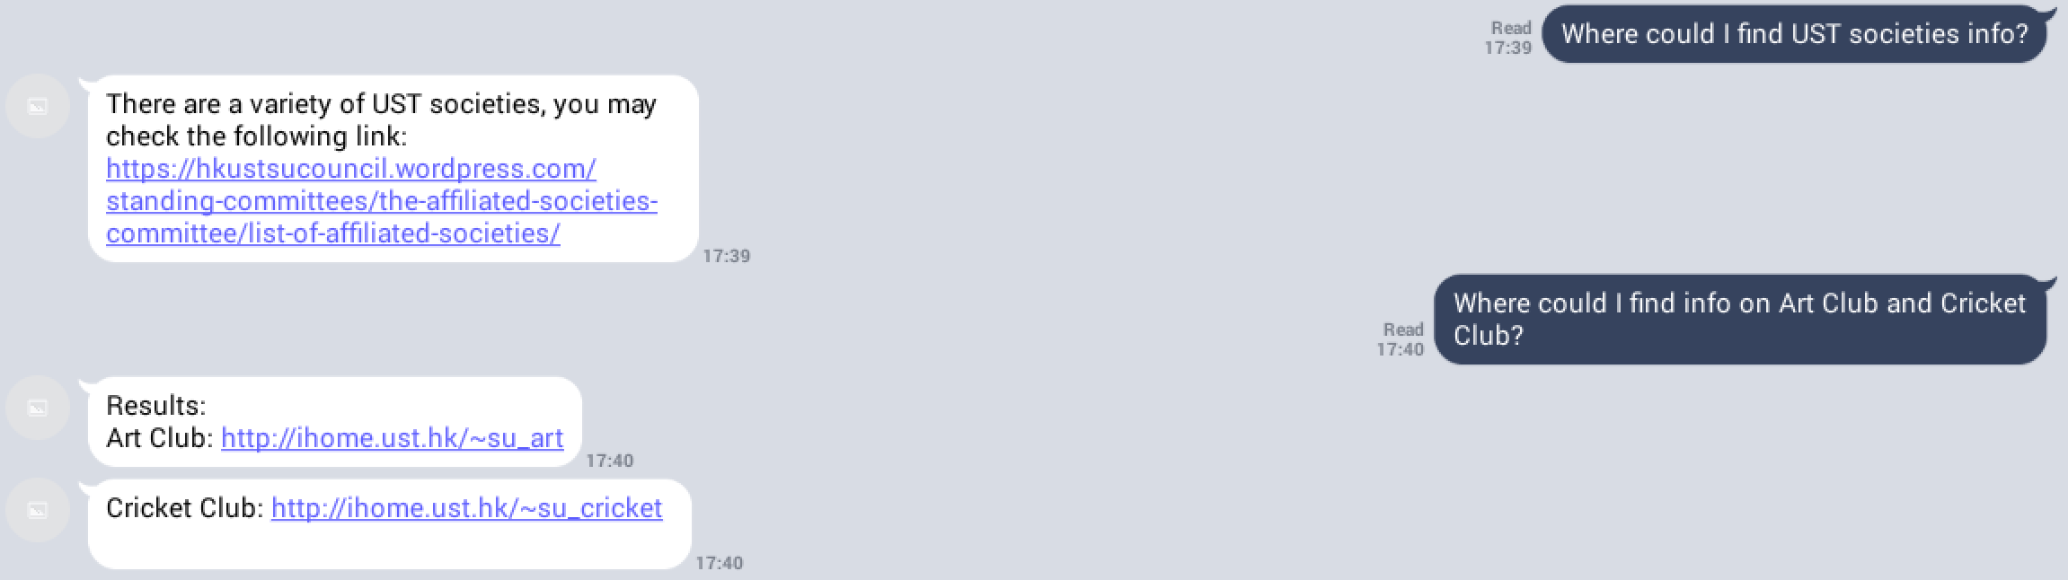

Slide 12
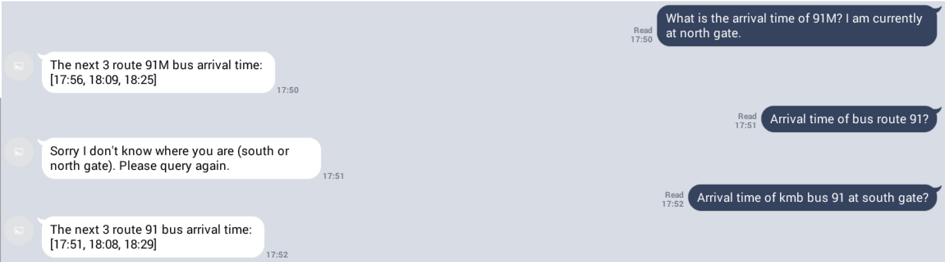
Transport <- Bus
Help users find estimated arrival time of bus route 91 and 91M at UST north gate / south gate based on current time
Arrival time are crawled from official KMB database

Slide 13
Transport <- Minibus
Help users find estimated arrival time of minibus route 11 based on current time
Minibus records are self-collected

Slide 14
Instruction
- Guide users how to properly use our chatbot

